Slide 1

Fake or Real News Predictor
Team Members:
Jaymee Liu
Yevheniia (Eyva) Ponomarenko
Neelansh Kohli
Dov Lantsman

Slide 2
Motivation & Summary
The idea behind “Fake or Real News Predictor” project was to apply Machine Learning techniques to predict whether a particular news story is real or fake.
We wanted to test if leveraging various ML techniques and applications could provide a good assessment of the veracity of an article or a news report
We also wanted to understand how and which ML model we can train to accomplish the task above in the best possible way
Our main hypothesis was that using a Generative Pre-Trained Transformer (neuro networks) will yield a better accuracy then a logistic model (baseline machine learning).

Slide 3
Model Summary
The input data was pulled from Kaggle. It contained 6200+ record. Each record contained 3 elements: a title of the article, text of the article and a classifier (real/false)
The data was used to train and test models using:
Simple models that parsed the title and text of the articles into individual words and used Random Forrest and Logistic Regression to classify each article. The results were checked against the actual classifiers
OpenAI Pre Trained (neuro network) model using embeddings translates text into a numerical format (embeddings) that represents the meaning of words and their relationships. It then analyzes these numerical representations to categorize the text into specific classes or categories based on its content.

Slide 4
Data Clean Up
Reading in the article data
Removing rows with NAs
Removing duplicate words
Removing special character while keeping apostrophes to preserve the meaning
Columns updated from Object data types to string
Making text not case sensitive
Standardizing the classification types

Slide 5
Model Training
Creating training and testing datasets with the following break down (2/3 training data vs. 1/3 Testing data) for ML models
Creating training and testing datasets with the following break down (20% training data vs. 80% Testing data) for OpenAI models

Slide 6
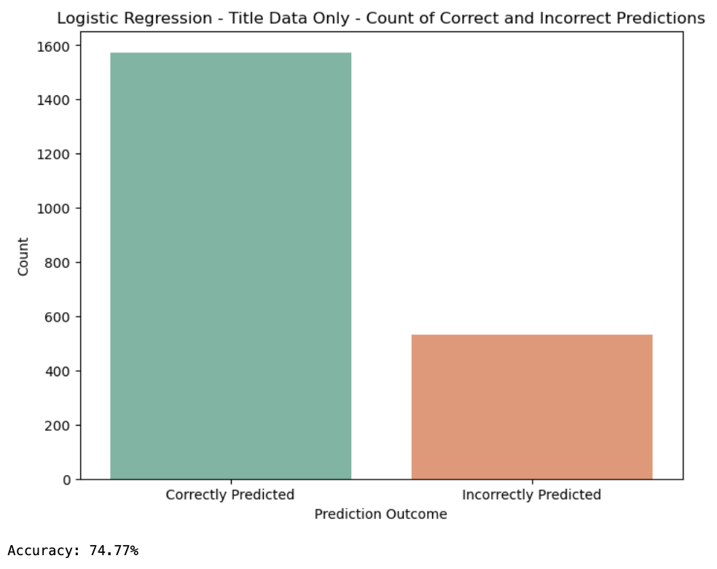
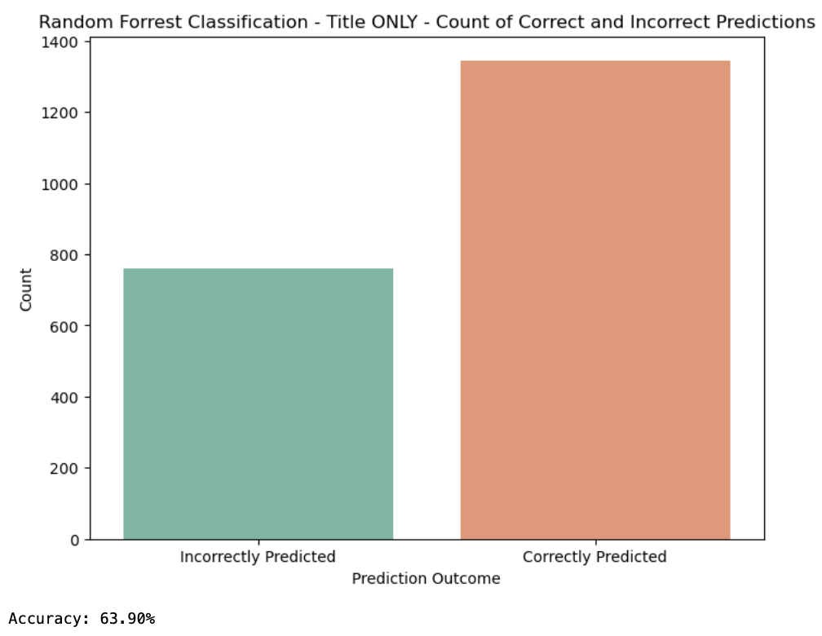
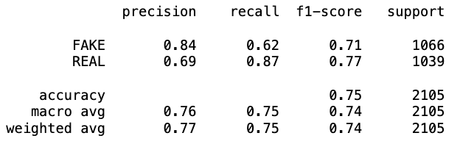
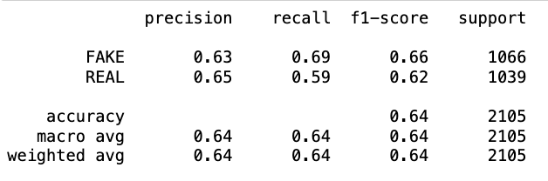
Simple ML Model - Less Data (Title ONLY)

Slide 7
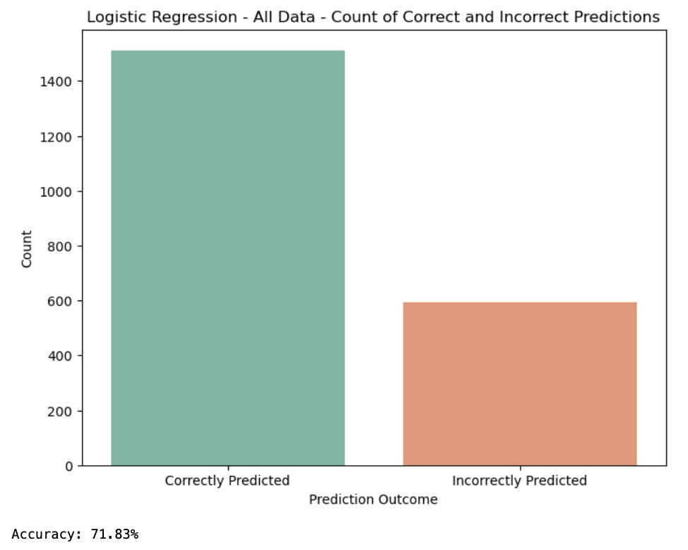
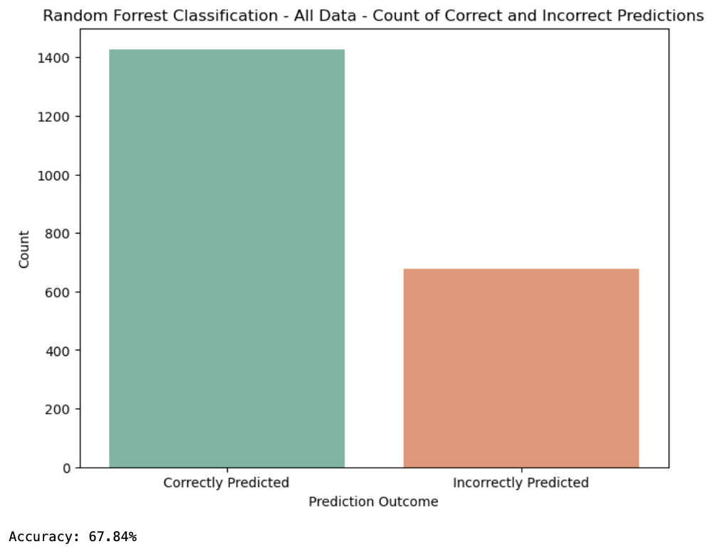
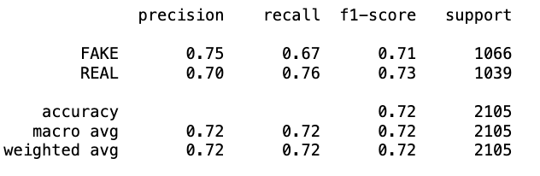
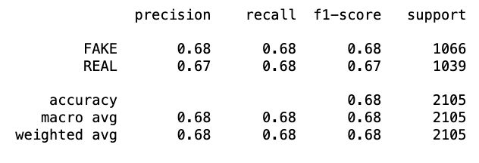
Simple ML Model - More Data (ALL)

Slide 8
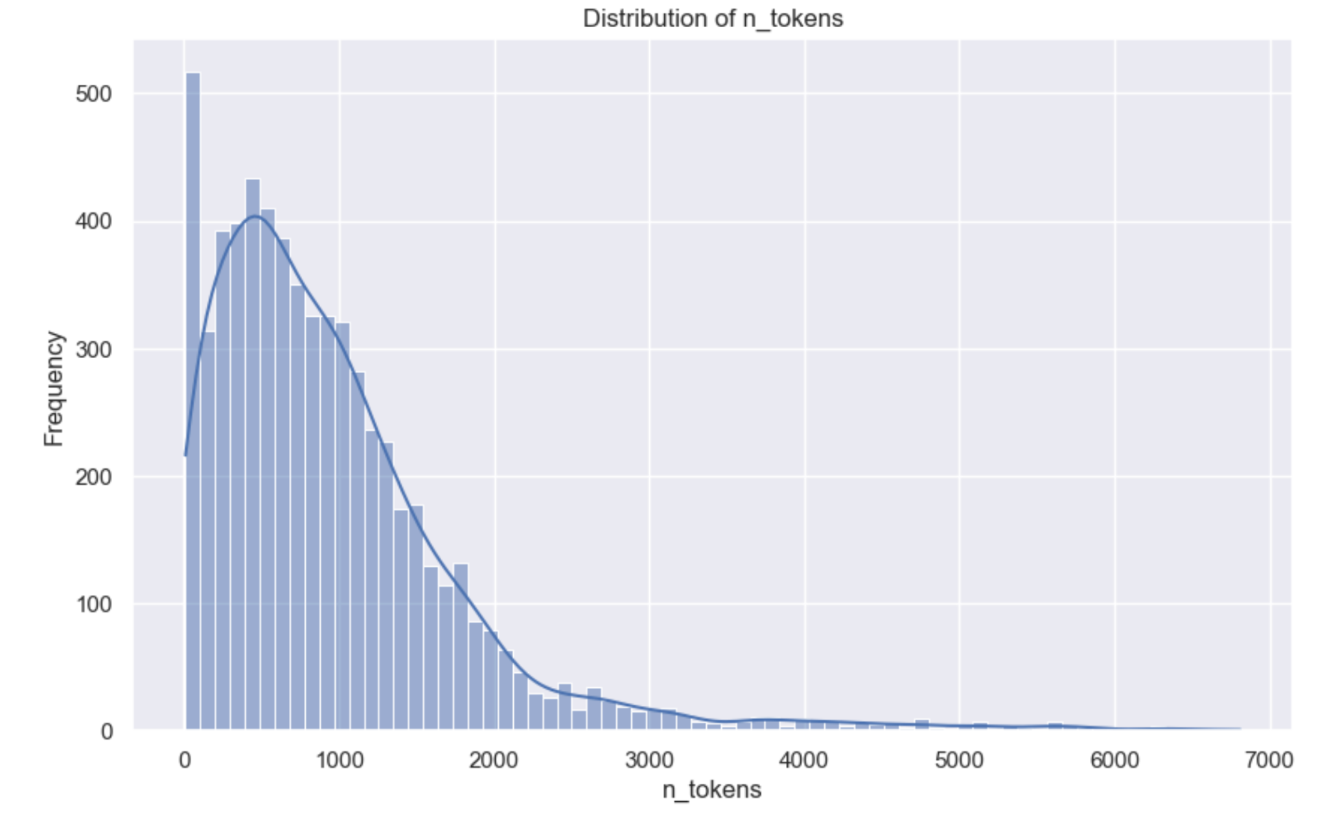
OpenAI Model - How we chose it
OpenAI's embedding models are designed to handle complex patterns in data, especially natural language. It can understand context and nuances in language, which a logistic regression model cannot. It can capture relationships between words in a sentence.
Hugging Face “Big Bird”:
handle a maximum 4,096 tokens
OpenAI:
handle a maximum 8,191 tokens

Slide 9
OpenAI Model - How it works
Convert the text data into embeddings:
The model processes given text and converts it into a high-dimensional vector (a list of numbers). Each dimension in this vector represents different features or aspects of the text. Each text sample in the dataset is passed through the embedding model to generate its vector representation.
Training and Classification:
Once embeddings ready, a classification model can be trained. This model learns to associate specific patterns in the embeddings with the corresponding classes (Fake/Real).

Slide 10
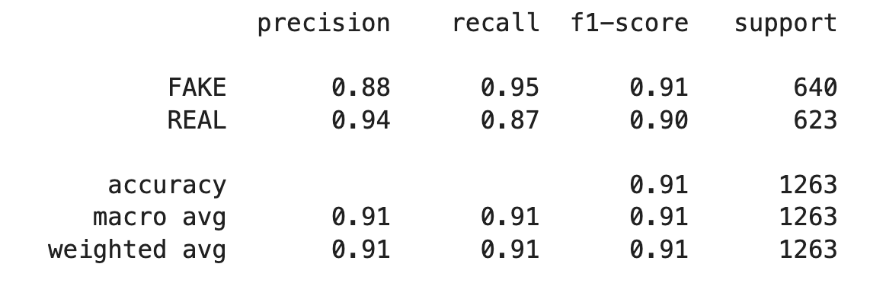
OpenAI Model - Evaluation
Accuracy: 91%
Precision: for "Fake" news, model predicts news as fake, it is correct 88% of the time. For "Real" news, the precision is higher - 94%.
Recall: For "Fake" news, the model successfully identifies 95% of the actual fake news. For "Real" news, the recall is 87%.

Slide 11
Conclusion
OpenAI Based model showed significantly higher accuracy rate of 91% vs 75% (for best performing simple model), which supported our initial hypothesis
OpenAI model used only 20% of the data available to train, yet still delivered superior results
The high accuracy classification rate of the OpenAI model proves viability of using this ML based model to determine the validity of news articles in a very time efficient way
This could make a powerful research tool which allows quickly discard invalid/fake news from a particular analysis on various economic, financial, scientific and political topics

Slide 12
Next Steps
We’ve discussed possibility of doing additional testing of articles and user inputs that were not part of our original data set
We’ve also considered leveraging OpenAI Model to do different type of assessment/classification of news articles to identify hate speech, political leanings, or to determine overall subject of the publication (economy, politics, travel, science, etc.)
Determining which words were more likely associated with fake or real classifications

Slide 13
Questions???

